Slide 1
An intelligent intrusion detection system (IDS) for anomaly and misuse detection in computer networks
Ozgur Depren, Murat Topallar, Emin Anarim, M. Kemal Ciliz*
Bogazici University, Electrical and Electronics Engineering Department
Information and Communications Security (BUICS) Lab
Expert Systems with Applications 29 (2005) p713 – p722
311552052 張壬豪

Slide 2
Outline
Introduction
System architecture
Method
Simulation result
Conclusion

Slide 3
Introduction
Interconnection among computer system growing rapidly
Unauthorized disclosure of information and destruction of data have to be protected
Intrusion detection system (IDS)

Slide 4
Introduction
IDS systems are divided into two categories [1] [2]
Host based IDS [3]
Network based IDS [4] [5]
IDS systems can be divided into two parts according to the detection approach [6]
Anomaly detection [7]
Detect anything that deviates from normal activity
Misuse detection [8] [9]
Use prior knowledge

Slide 5
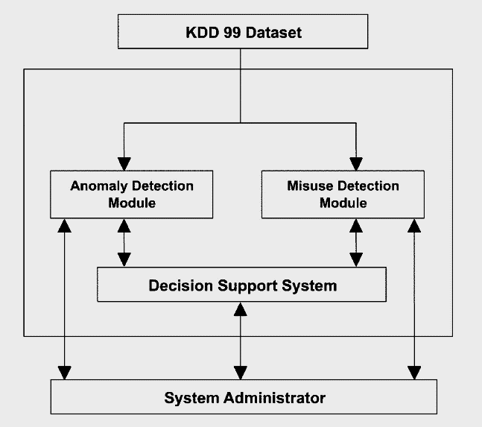
System architecture
KDD Cup 99 intrusion detection dataset [10] [11]
Anomaly detection
Self-organizing map (SOM)
Misuse detection
J.48 decision tree
Decision Support System (DSS)
Rule-based DSS

Slide 6
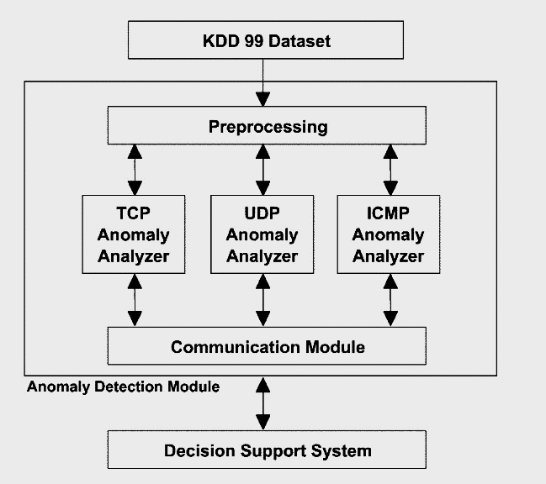
Anomaly detection
Determine whether the test data belong to normal or abnormal
Binary output
Preprocessing
Anomaly analyzer
Self-organizing map (SOM)
Communication module

Slide 7
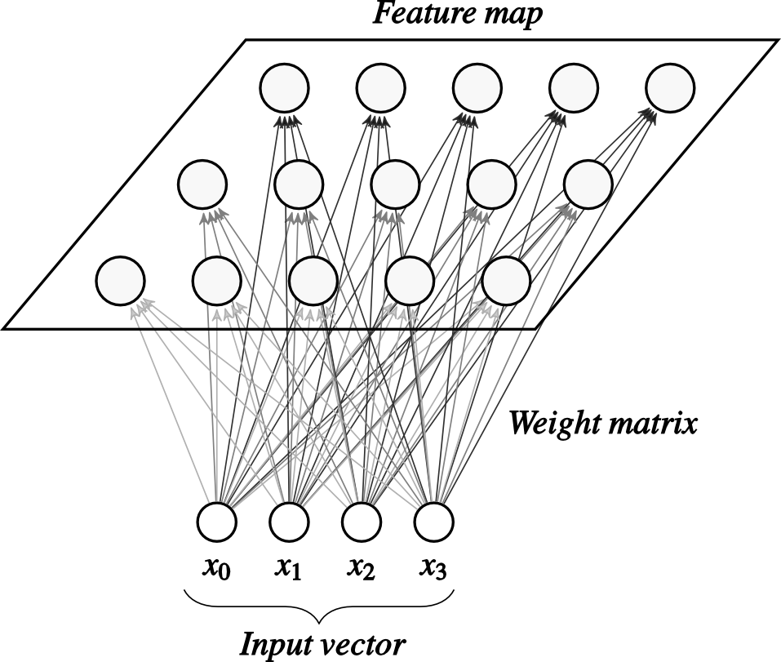
SOM
Analyzing and visualizing high dimensional data [12]
Cluster algorithm
Unsupervised learning
Competitive learning
Map nonlinear relationships between high-dimensional to usually two-dimensional grid of nodes [13]

Slide 8
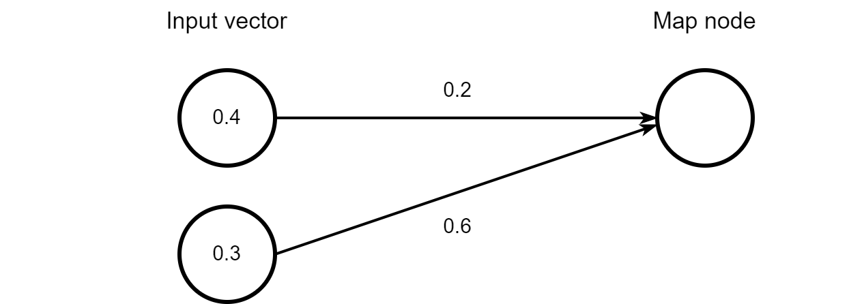

SOM
Find the closest node in the map called Best Matching Unit (BMU)
Distance defined by
$${||x_{i}−w_{i}||}_{2}$$
$$distance=\sqrt{{\left(0.4−0.2\right)}^{2}+{\left(0.3−0.6\right)}^{2}}=0.36$$

Slide 9
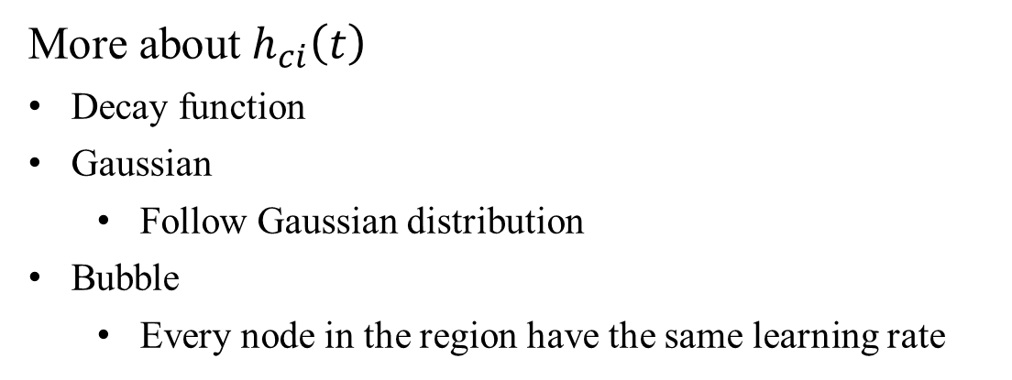
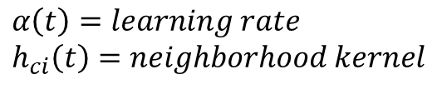
SOM
Update node’s weights within the radius
$$w_{i}\left(t+1\right)=w_{i}\left(t\right)+α\left(t\right)h_{ci}\left(t\right)[x(t)−w_{i}(t)]$$
$$α\left(t\right)=learning rate \\ h_{ci}\left(t\right)=neighborhood kernel$$
More about $h_{ci}\left(t\right)$
Decay function
Gaussian
Follow Gaussian distribution
Bubble
Every node in the region have the same learning rate

Slide 10
Preprocessing
41 features
6 basic features are used
Duration of the connection
Protocol type
Service type
Connection status flag
Total bytes sent to destination host
Total bytes sent to source host

Slide 11
Preprocessing
SOM usually work on normalized numeric data
Alphanumeric features need to do label encoding
Protocol type
Service type
Connection status flag
[0, 1] normalization
Protocol | Label
TCP | 0
UDP | 1
ICMP | 2

Slide 12
Preprocessing
Pre-simulation results of SOM did not give acceptable results
After normalization, source/destination bytes become closer and cannot be detected by the SOM
 | Destination bytes | After [0, 1] normalization
DoS | 0 | 0
normal | 40 - 50 | 1e-5

Slide 13
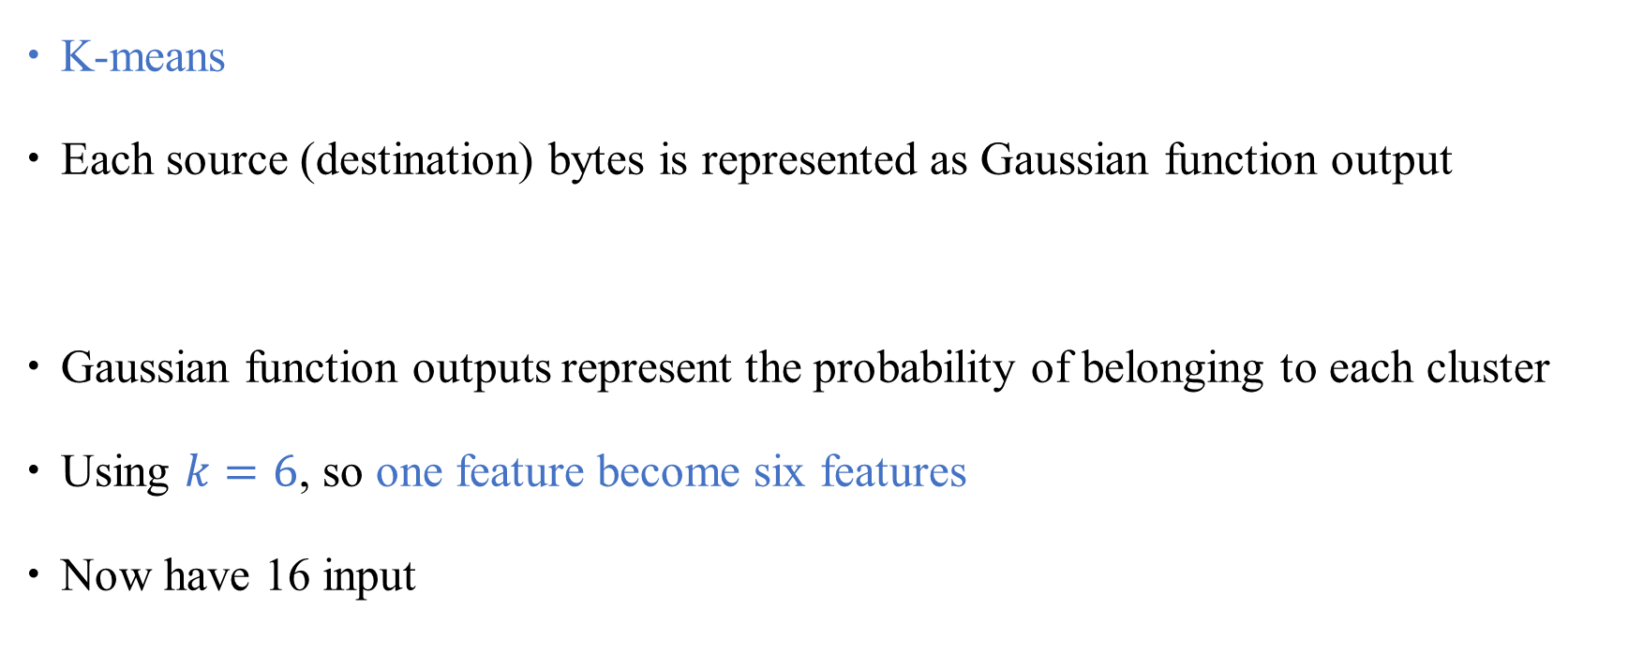
Preprocessing
K-means
Each source (destination) bytes is represented as Gaussian function output
Gaussian function outputs represent the probability of belonging to each cluster
Using $k=6$, so one feature become six features
Now have 16 input
$$\left(Source byte values\right)\overset{→}{k−means} [\left(m_{1},σ_{1}^{2}\right),(m_{2},σ_{2}^{2})⋯(m_{k},σ_{k}^{2})]$$
0.23
0.67 0.34
0.15
0.49
0.26
Source bytes = 47 bytes

Slide 14
Anomaly Analyzer
Train SOM model with the corresponding normal traffic data
Normal
around one or more cluster centers
outside of the normal clustering
Abnormal
inside but with high quantization error

Slide 15
Outside normal
Normal cluster

Slide 16
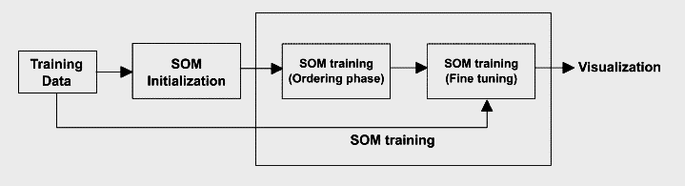
Anomaly Analyzer
SOM training
SOM classification
Classifier parameters calculation
Classify

Slide 17
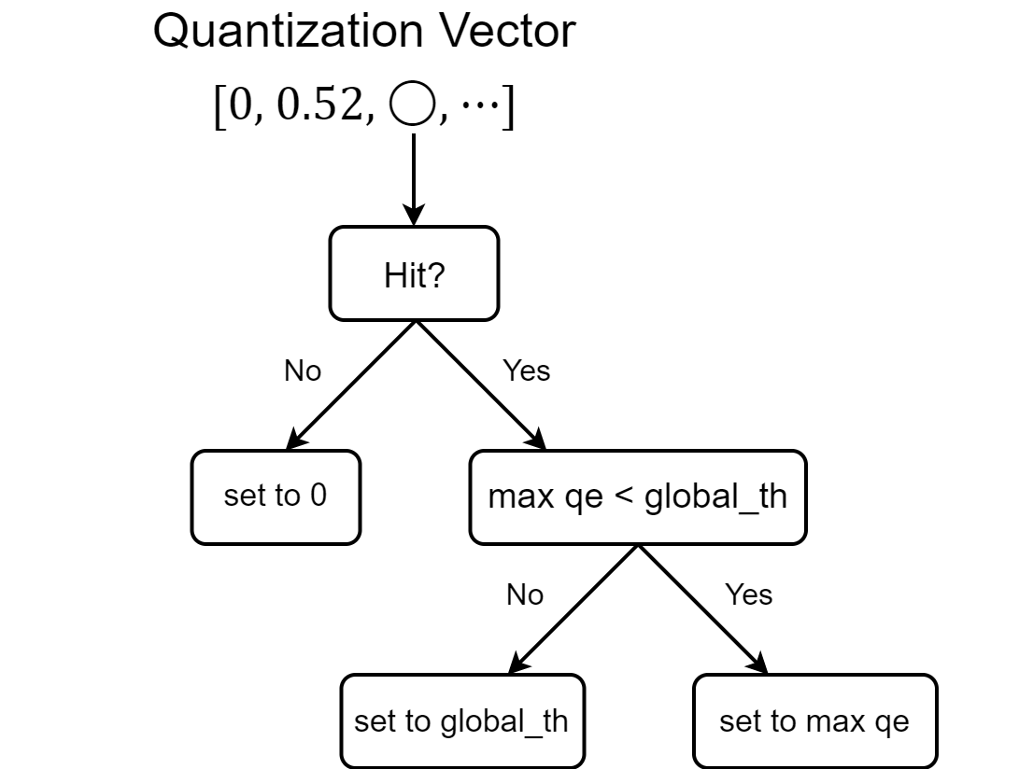
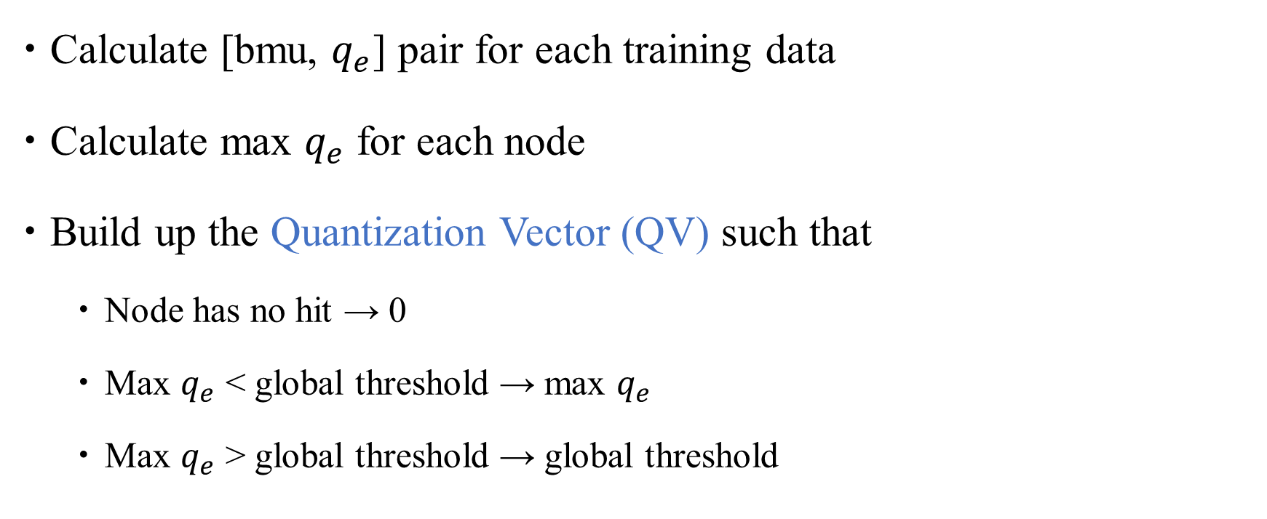
SOM classification
Calculate [bmu, $q_{e}$] pair for each training data
Calculate max $q_{e}$ for each node
Build up the Quantization Vector (QV) such that
Node has no hit → 0
Max $q_{e}$ < global threshold → max $q_{e}$
Max $q_{e}$ > global threshold → global threshold

Slide 18
Protocol type | Map size
TCP | (15, 15)
UDP | (8, 8)
ICMP | (6, 6)
Never hit
Some data’s BMU

Slide 19
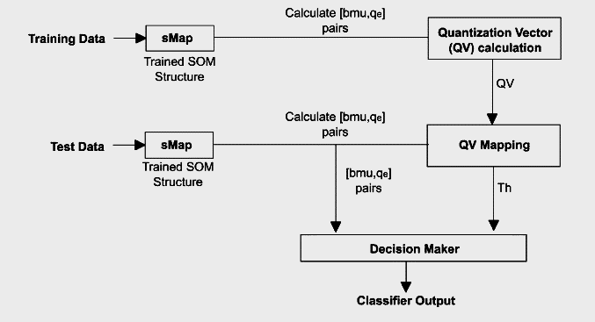




SOM classification
Calculate [bmu, $q_{e}$] pair for test data
Get the threshold (Th) by checking QV
$$Th=QV[bmu]$$
$$q_{e}>Th→attack$$
$$q_{e}<Th→norma$$

Slide 20
Misuse detection
Usually use rule-base approach [14]
Requires signature of an attack to be studied before
The rules are generated from decision tree
Classify the attacks

Slide 21
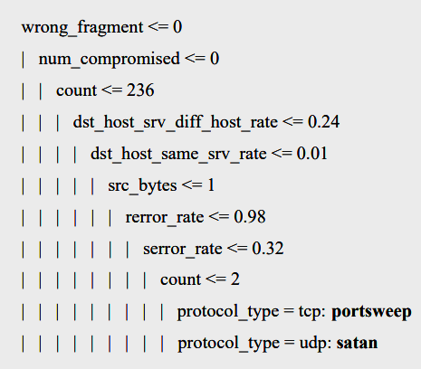
Decision tree
Using package WEKA to implement, called J48 decision tree [15] [16]
All the features are used to generate rules
Using 10-fold cross-validation [17] [18]
Most accurate error estimate

Slide 22
Decision support system
Interpreting the results of both anomaly and misuse
Rule-based DSS
Simple user-define rules

Slide 23
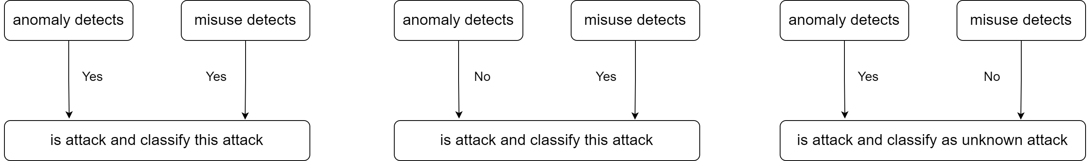
Decision support system
3 main rules

Slide 24
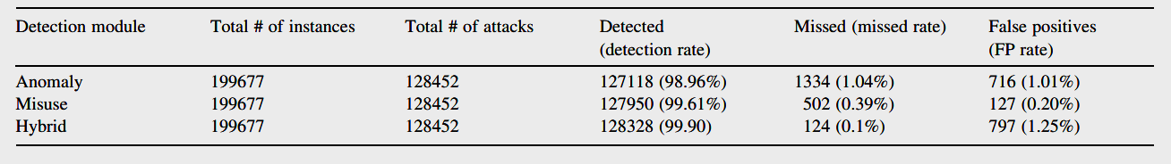
Simulation results
Anomaly model have higher FP rate than misuse model but can detect some type of attack that misuse model misses such as ‘ftp write’

Slide 25
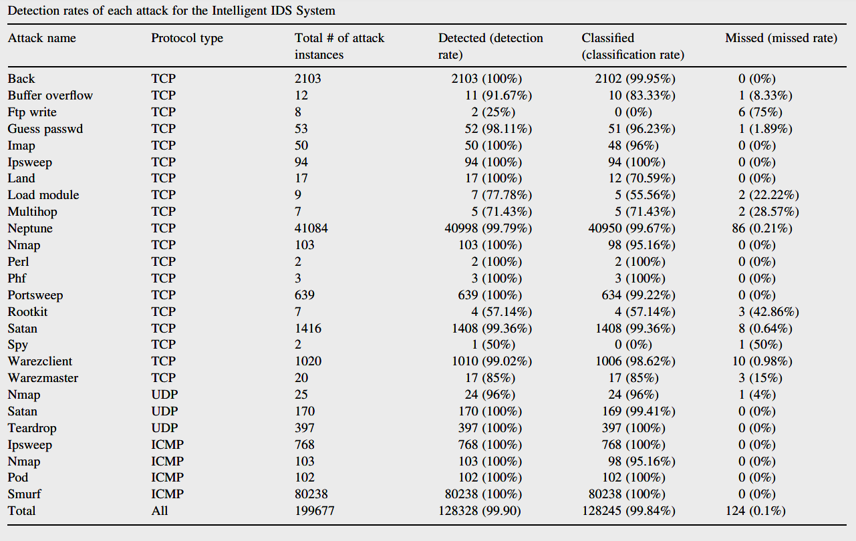
Simulation results

Slide 26
Conclusion

Slide 27
Reference
[1] Anderson, J. (1995). An introduction to neural networks. Cambridge: MIT Press.
[2] Tiwari, P. (2002). Intrusion detection Technical report, department of electrical engineering indian institute of technology, Delhi.
[3] Lichodzijewski, P., Zincir-Heywood, A., & Heywood, M. (2002). Hostbased intrusion detection using self-organizing maps Proceedings of the 2002 IEEE IJCNN, Hawaii, USA.
[4] Ingham K. (2003). Protecting network servers.Technical Report, Department of Computer Science, University of New Mexico.
[5] Lichodzijewski P. (2002). Network based anomaly detection using self organizing maps, Technical Report, Nova Scotia: Dalhousie University Halifax
[6] Rhodes, B., Mahaffey, J., & Cannady, J. (2000). Multiple self-organizing maps for intrusion detection Proceedings of the 23rd national information systems security conference, Baltimore, MD.
[7] Kemmerer, R. A., & Vigna, G. (2002). Intrusion detection: A brief history and overview. IEEE Security and Privacy Magazine .

Slide 28
Reference
[8] Kumar, S., & Spafford, E. (1994). A pattern matching model for misuse intrusion detection Proceedings of the 17th national computer security conference pp. 11–21.
[9] Kumar, S., & Spafford, E., (1995). A software architecture to support misuse intrusion detection, Technical report, Department of computer Sciences, Purdue University, (CSD-TR-95-009).
[10] DARPA Intrusion Detection Evaluation, MIT Lincoln Laboratory
[11] Stolfo SJ, et al., KDD cup 1999 data set, Irvine: University of California. KDD repository
[12] Kohonen, T. (2001). Self-organizing map (3rd ed.). Berlin: Springer-Verlag.
[13] Kayacik H.G. (2003). Hierarchical self organizing map based IDS on KDD benchmark, MS Thesis, Middle East Technical University.
[14] Cannady J. (1998). Artificial neural networks for misuse detection, Proceedings of the 1998 National Information Systems Security Conference (NISSC’98), (pp. 443–456). Arlington, VA.

Slide 29
Reference
[15] Quinlan, J. R. (1993). C 4.5: programs for machine learning. San Mateo: Morgan Kaufmann Publishers.
[16] Witten, I. H., & Frank, E. (1999). Data mining: practical machine learning tools with Java implementations. San Francisco: Morgan Kaufmann Publishers.
[17] Clare A. (2003). Machine learning and data mining for yeast functional genomics, PhD Thesis, Department of Computer Science University of Wales, Aberystwyth.
[18] Kohavi, R. (1995). A study of cross-validation and bootstrap for accuracy estimation and model selection. Proceedings international joint conference on artificial intelligence pp. 1137–1143.

